Slide 1
Investigating Media Transparency
David Pfahler
Institute of Computer Graphics and Algorithms
Vienna University of Technology

Slide 2
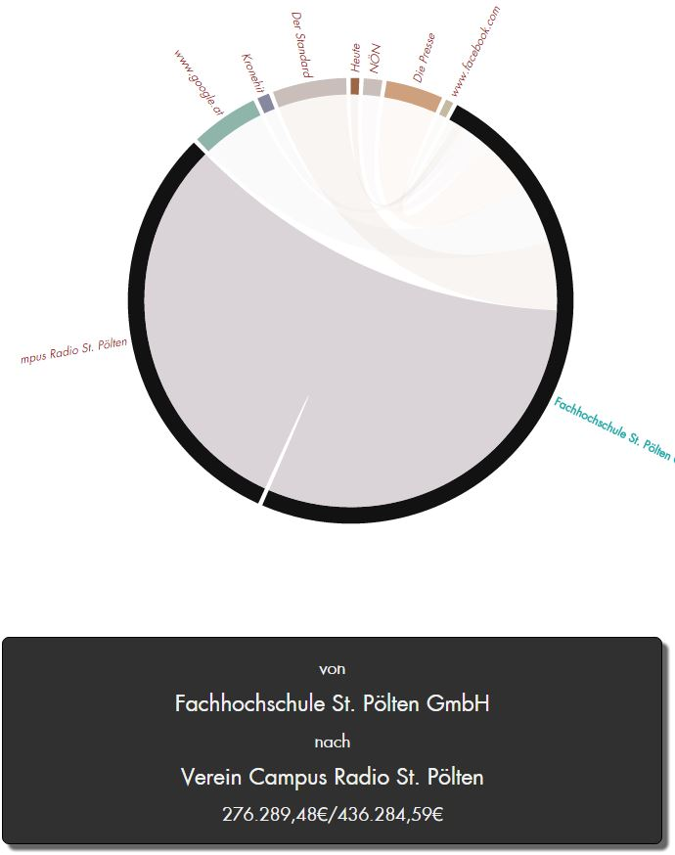
Overview
Motivation
Related Work
Dashboard
Visualizations
Interactions
Evaluation

Slide 3
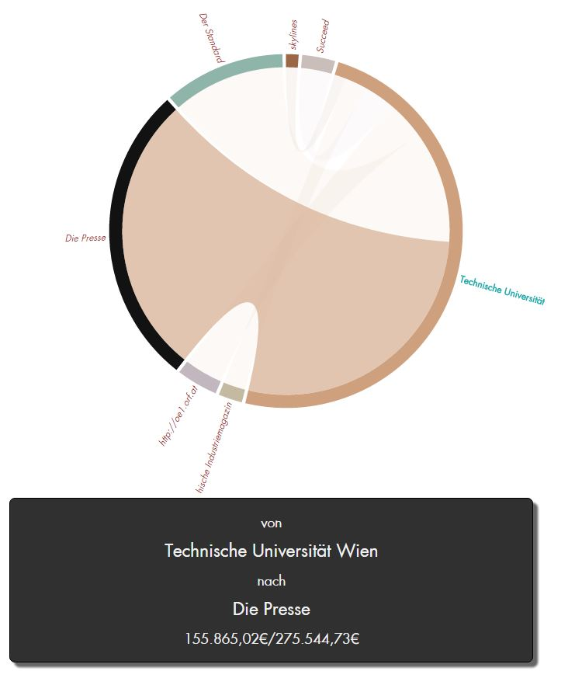
Motivation
Existing Visualizations
Data Exploration
Data Wrangling

Slide 4
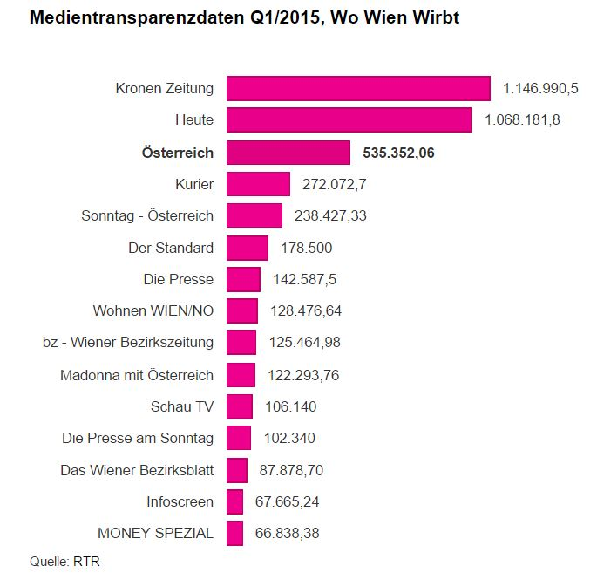
Related Work
[M. Hametner]
Not interactive Visualizations to present data
http://derstandard.at/2000017464403/Regierungsinserate-406-Millionen-im-ersten-Quartal

Slide 5
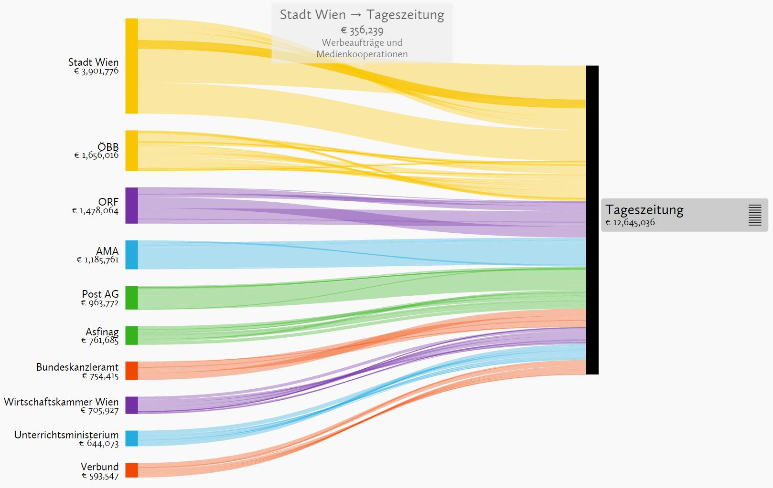
Related Work
[F. Lang]
Uses Grouping of the media entities
http://www.paroli-magazin.at/555/

Slide 6
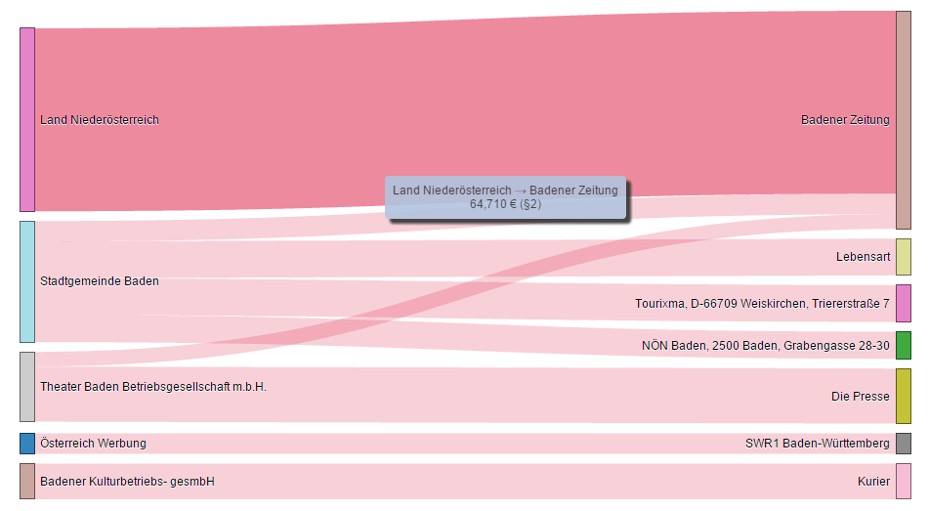
Related Work
[S. Peter, B. Amir, S. Mercedes, and V. Stephan]
Multiple not connected Visualizations
http://www.medien-transparenz.at/

Slide 7
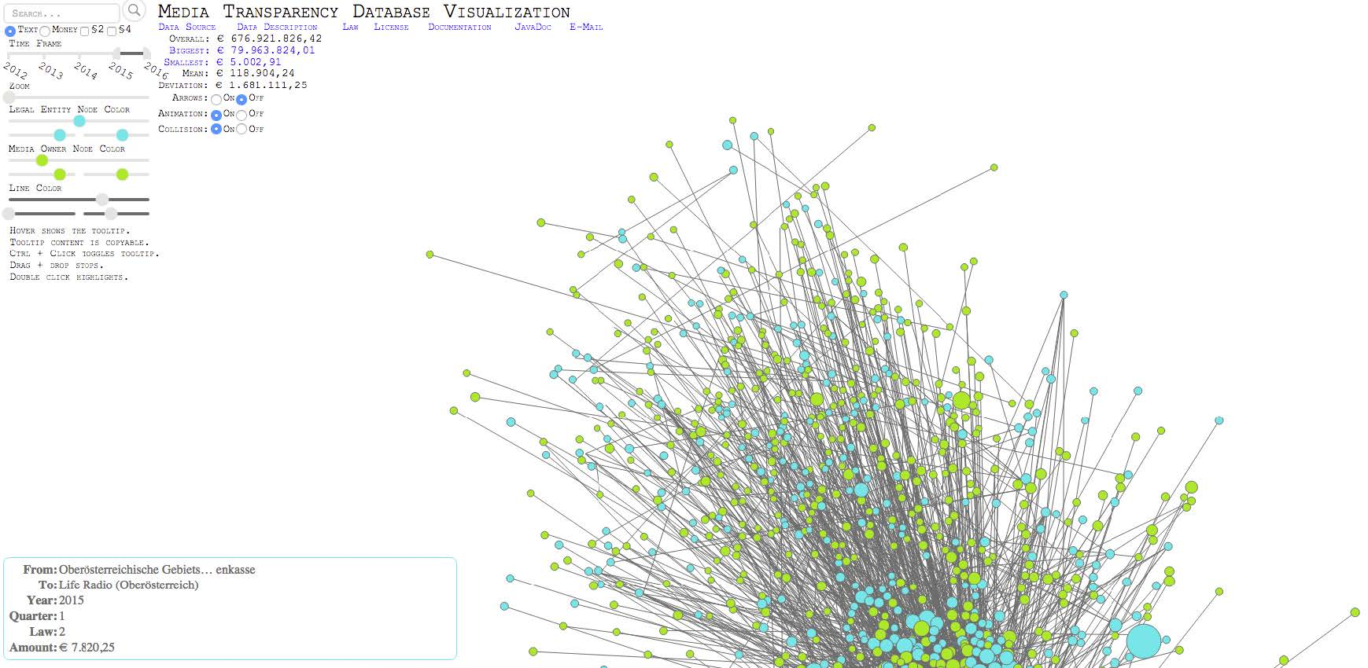
Related Work
[M. T. Schrempf]
Force directed node link diagram
(website down)

Slide 8
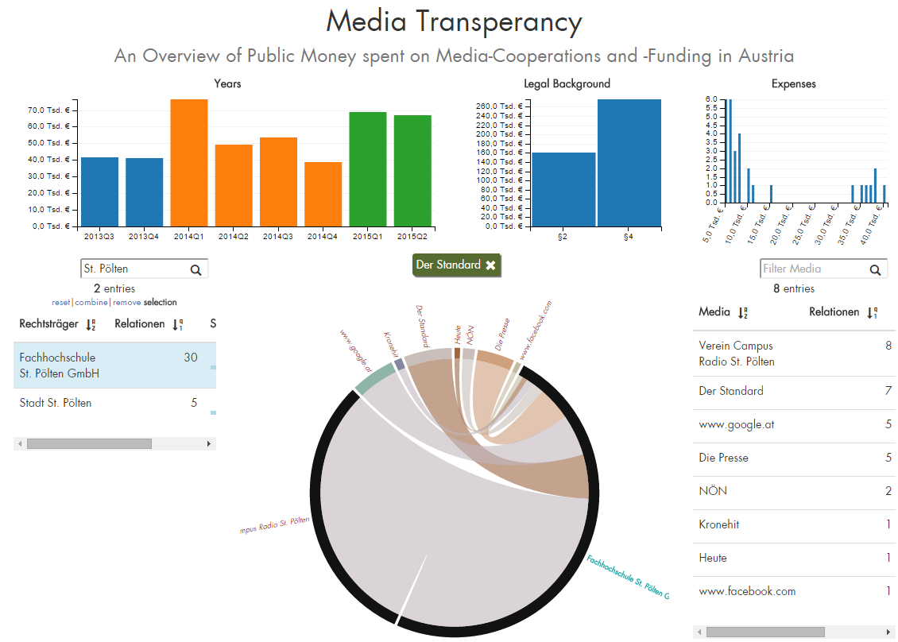
Dashboard

Slide 9

Dashboard - Visualizations

Slide 10
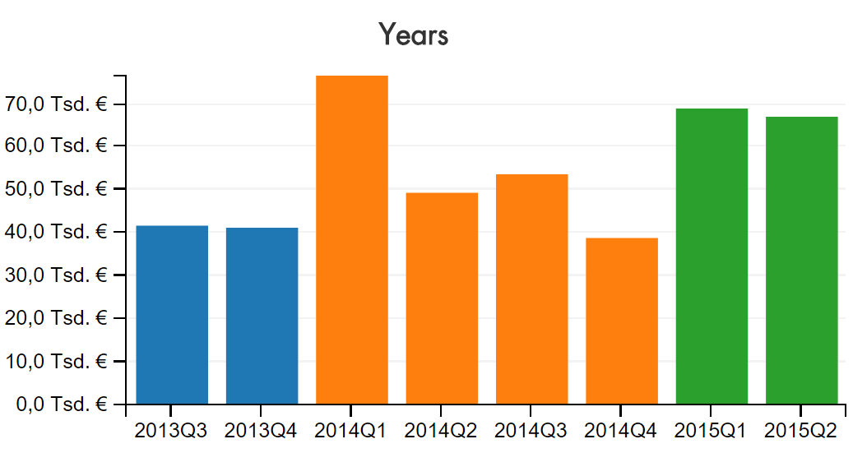
Dashboard - Visualizations

Slide 11
Dashboard - Visualizations

Slide 12
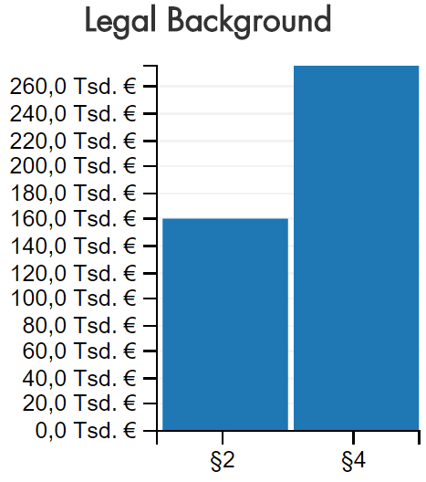
Dashboard - Visualizations

Slide 13
Dashboard - Visualizations

Slide 14
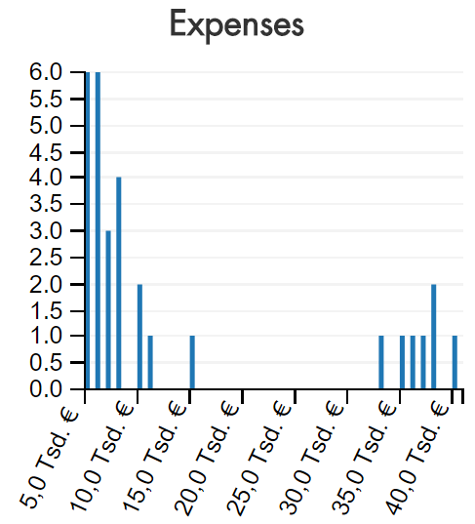
Dashboard - Visualizations

Slide 15
Dashboard - Visualizations

Slide 16
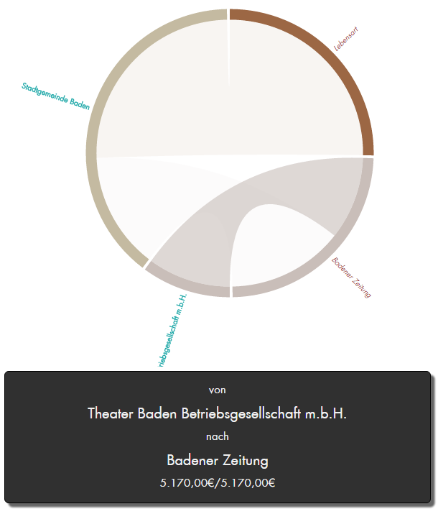
Dashboard - Visualizations

Slide 17
Dashboard - Visualizations

Slide 18
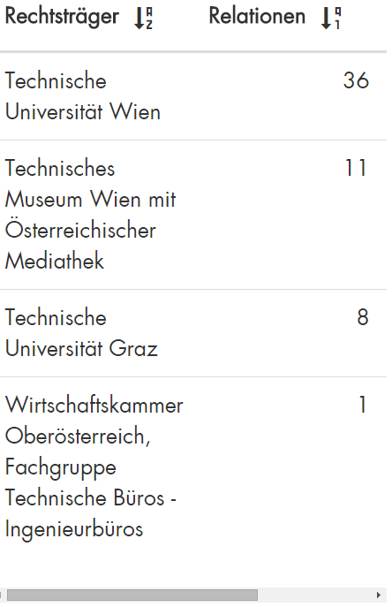
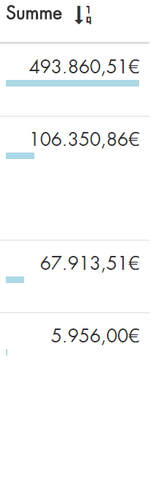
Dashboard – Visualizations

Slide 19
Dashboard – Interaction
DEMO

Slide 20
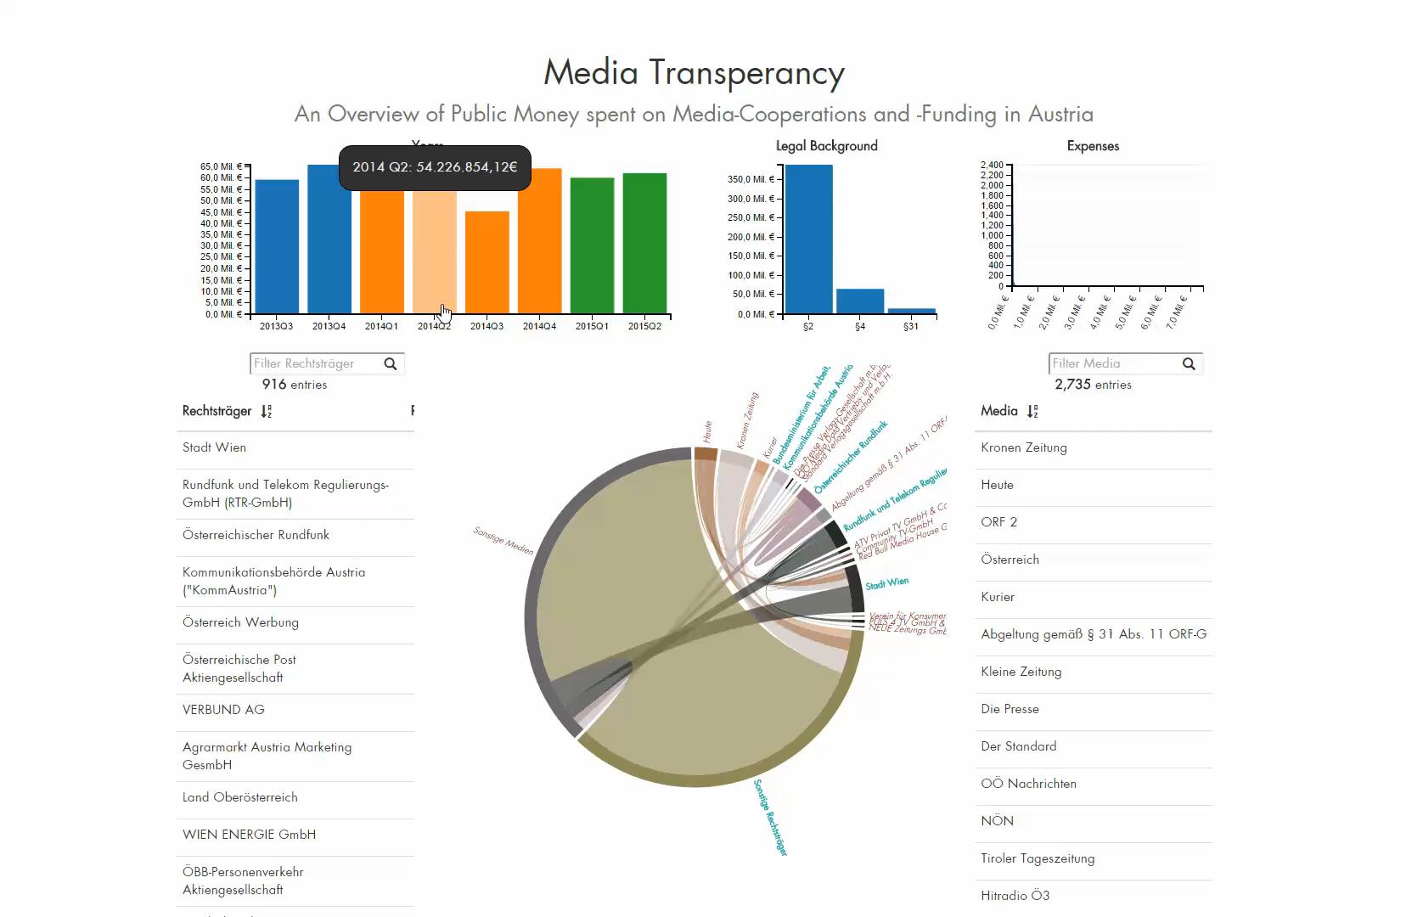

Slide 21
Dashboard – Evaluation
Informal Interviews
6 Questions …
In which quarter did the “WU Wien” spend most on advertisements? To whom?
…
Feedback on
Design
Interactions

Slide 22
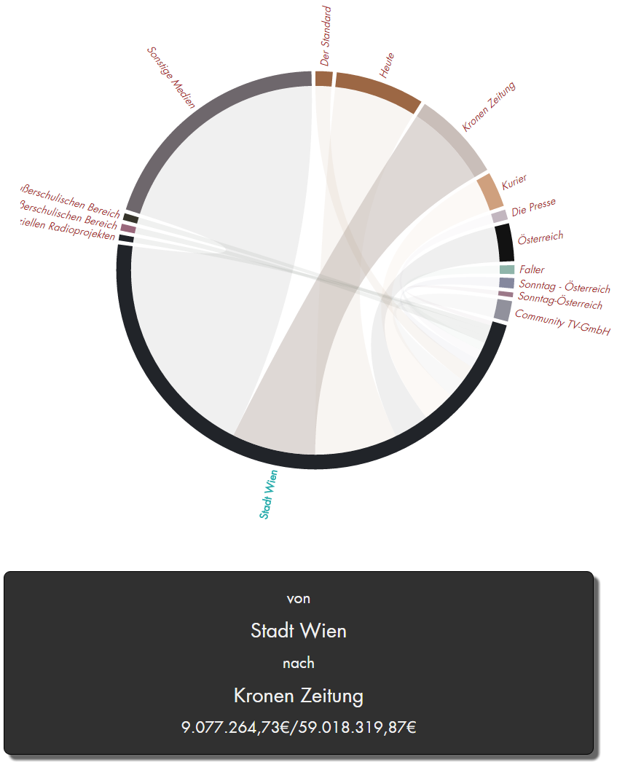
Investigating Media Transparency
Institute of Computer Graphics and Algorithms
Vienna University of Technology
David Pfahler

